Slide 1

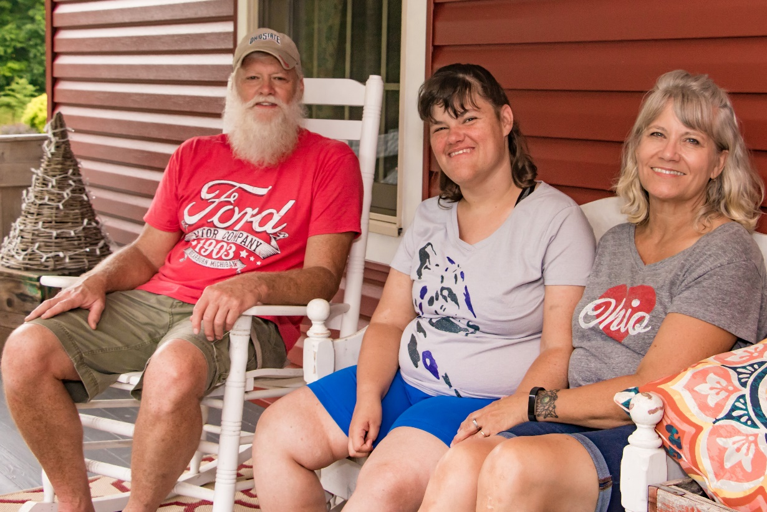
Building Bridges: Developing Valued Relationships
Between DSPs and Families
Ann Weisent – DSP & Provider Support Manager
Meredith Mendoza-Gillotte - Family Outreach & Education Coordinator

Slide 2
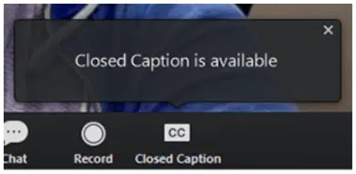
Accessibility on Zoom
To view captions in Zoom, click on the Captions icon. Alternatively, you may find a link in the chat to open captions in a separate window.
If an ASL interpreter is present, they will always be spotlighted and visible.

Slide 3



Types of Relationships
Personal Relationships
Professional Relationships
Blended Relationships
Notes:
Let’s talk about different types of relationships. We are all familiar with personal relationships, those relationships that we have with family, spouse, significant other and our friends. Personal relationships are intimate in nature, informal, and emotional driven. They generally grow over time in their level of affection.
We are also familiar with professional relationships which are usually between an employer and employee or co-workers. These are typically based upon a shared mission or vision and are formal and duty driven with an expected outcome of monetary compensation.
But blended relationships, who has ever heard of a blended relationship? A blended relationship is when a personal and professional relationship overlap. Examples of a blended relationship can include when husbands and wives work together or when friends develop a business partnership. It is a co-mingling of the informal, emotionally driven traits of a personal relationship with the more structured, outcome-based, vision driven components of a professional relationship.
The relationship between a person and their family, and the direct support professional who works with them often becomes a blended relationship and building a blended relationship takes planning, effort, boundaries, and commitment from everyone involved in this unique relationship.
Families describe direct support professionals in different ways. While DSPs are a necessary part of providing services for a loved one, families sometimes see the DSP as an intruder into their lives and homes. While there to provide needed services, the DSP becomes a “necessary intruder”, someone who has to be there in order to help meet the needs of the person and their family, but the relationship is strictly professional. Other families will describe their direct support professionals as being “part of the family”, someone with whom they have developed a personal relationship.
It is important that there is a balance between the professional “intruder” view of the direct support professional’s role and the more informal, “part of the family” role of the direct support professional. Defining roles in a relationship is about creating a flexible system that adapts to each person’s needs, strengths, and responsibilities, and doing so from the beginning will help to ensure that the blended relationship has accurate and clear expectations, boundaries and responsibilities that are understood by everyone.

Slide 4
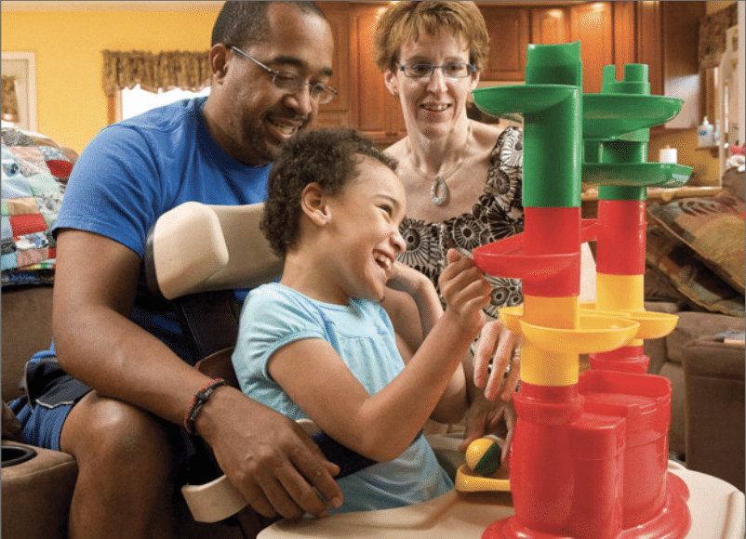
Keys to Successful Relationships?
Communication
Well Defined
  Roles
  Responsibilities
Collaboration
  Ability to learn from each other
  Consistently make time for each other
Respect
  Recognizing and understanding differences
  Open and honest communication
Notes:
Communication is the cornerstone of a healthy relationship.
Communication is essential from the beginning to help the relationship develop and must be ongoing as the relationship grows to ensure that everyone involved feels heard, that everyone feels understood, and so that challenges can be addressed quickly and effectively.
Families and DSPs should be comfortable enough with each other to be open and vulnerable in their conversations as the relationship grows. Listen to each other and communicate without judgement.
Successful relationships have well defined roles and responsibilities. This allows all parties to work together as a team to meet needs without unnecessary duplication or for anyone to feel like they are “stepping on toes”, or veering out of their “swim lane”, both which can create feelings of frustration and of not being respected for what you contribute to the relationship. DSPs should make sure that if they are unsure if a service or support is needed, that they engage with the person served and their family to identify their role in meeting the need. Successful relationships have a balance that allows everyone to feel like they are needed and an important contributing part of the relationship.
Collaboration strengthens and enhances successful relationships. Families and DSPs who work together to meet individual needs form strong partnerships that lead to better outcomes for the person supported. Involve the person and their family in discussions about how all the different types of supports (paid and upaid) being provided to the person can interact and complement each other.
Being a respected improves the quality of life for everyone, including people living with disabilities. Recognizing and understanding the differences between ourselves those we support, and their families creates an opportunity for not only mutual respect within the relationship, but also an opportunity to learn about differences such as race, ethnicity, religion, etc, but culture extends beyond these obvious areas and can include family dynamics, values, and upbringing. It is important for everyone in this blended relationship to be aware of these dynamics to help foster a respectful and positive relationship. Remember details about each other's lives. For example, if someone’s culture celebrates a specific holiday, remembering and recognizing that holiday, even if different than those you celebrate is a sign of respect.

Slide 5
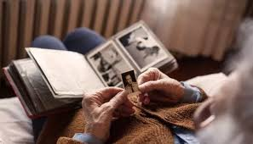

Reciprocal Interviewing
What is a Reciprocal Interview?
  Willing and Able
  Prepared to Provide Support
  Ensuring a “Good Fit”
  Improved Rate of Retention
Notes:
Reciprocal agreement includes both parties asking each other questions to determine if you are a good fit for each other.
Just like with any job interview, the applicant typically will go into the interview with questions that they want to ask the employer to help determine if the company is a good fit for them. When interviewing for a caregiving position, many direct support professionals don’t think to ask questions.
In a typical job interview, people will ask about things like dress code, flexibility, sick leave/vacation, company’s mission/vision. These are all great questions to help someone decide on whether a job is the right fit for them. These questions are just as important when considering a direct service position. If you are interviewing to be an agency employed DSP, you will go through an interview with the agency and these questions may make sense as the employment with the agency is one that is more traditional, but if you are an independent provider, or an agency DSP being connected with a family, how many of you think to ask these questions of the person or their family?
Some examples of how things are the same – Mission/Vision – for a company, we may want to better understand the goals of a company, what is that company trying to accomplish, what outcomes do they expect from you in your job, how does your role/responsibility fit in to the bigger agency mission and vision. This same question can be asked of the person or family that you will be working with. It is important to know what is important to them, where they see themselves, their family or their family member in the next year, five years, etc., and how you they see you, in your role as a DSP fitting in to their mission and vision.
Flexibility – its helpful to know how flexible your employer is going to be. DSPs strive for a manageable work/life balance. Knowing and understanding the schedule and how to ask for changes or being able to be flexible in when you provide the necessary supports is important in ensuring that you are meeting the needs of the person. If you need to modify the schedule, can that be done without jeopardizing the health and safety of the person? What is the process for asking to modify the schedule?
Understanding family dynamics, family needs, and cultural differences. Asking about these things allows you to ensure that you are a good fit for the family. Knowing from the beginning whether or not there are values and beliefs that non-negotiable will help you determine if you are able to meet the needs of the person. For example, the person supported and their family may find having a strong tie to the church of their choice as a non-negotiable and they may need a direct support professional who is willing to support them in participating in church activities. This is important to understand so that you can decide if this is something that you are willing and able to provide. Families may have situations where there is a blended family and the roles of parents, step-parents, and other family members are unique or different than the roles within your own family. Understanding those family dynamics and how they affect your role and responsibilities is necessary to a successful relationship. Who is the decision maker within the family unit? Who does the DSP go to to discuss issues/concerns, schedule changes, etc. Asking these questions as part of the interviewing process will help you to understand the family perspective and make the decision of whether this is the right fit for you. Being aware of these things and understanding the reasons and expectations can help to create a more sustainable relationship between the DSP and the family.
One thing to keep in mind is that questions may be different depending on if the person you will be supporting is an adult or a child. With adults, it is important to understand the role of the family member in the life of the person with lived experience. Are they the person’s guardian? If not, knowing how involved the person wants their family member to be in your role as service provider is essential. Make sure that you understand the role of the family with the person that you are supporting. Ask your employer or the SSA if you are not aware of the legal status and make sure that the person is involved in defining the role their family member will play in managing or helping to manage service deliver.

Slide 6
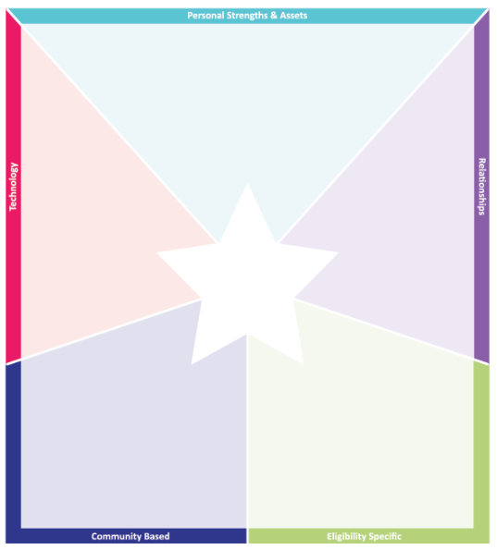
Using Charting the Lifecourse in Building Valued Relationships
What is Charting the Lifecourse
How Can it Assist in Building Valued Relationships
Notes:
Meredith

Slide 7
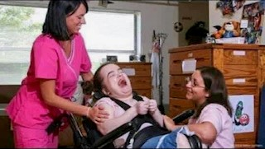
Building Valued Relationships
Starts from day one
Helps to set professional and personal boundaries
Work together as a team
Learn from each other
Find solutions that work for everyone
Charting the Lifecourse - Family Perspective Portfolio
Notes:
Purposely work to build a valued relationship starts at day one.
It allows us to set personal and professional boundaries
It supports the team process by creating connections between team members and emphasizing the role of the team in assessing, identifying and prioritizing what is important to and for the person, developing the person centered plan, and clearly outlining service delivery roles and responsibilities.
It focuses on learning from each other and it offers opportunities to work together to identify barriers to successful service delivery and allows us to identify solutions that work for everyone.
So how can we get started on the right foot from the very beginning? Charting the Lifecourse offers a number of principles that help people to live their bests lives. There are some great tools available through the Charting the Lifecourse to assist you in starting off on the right foot as you work with people and their families. These valuable tools, which Meredith is going to go over with us, can help guide the discussion around service delivery and meeting the person’s needs in a way that ensures that the DSP and the team is aware of the family perspective. MEREDITH – can you include an example of “Setting Professional and Personal Boundaries” (ie; the thought of becoming “part of the family”, a “necessary intruder”?, Working together as a team – ensuring that everyone on the team, in all environments are using the same technics to help a person learn a skill. Learning from each other – Learning about different cultures, religions, ethnicities, etc. And Finding Solutions – Everyone sharing what has worked for them and coming to consensus on how to use what everyone has shared to solve a problem or address an unmet need?

Slide 8
Importance of Self-Care for DSPs
Part of Charting the Lifecourse is a tool for the direct support professional to capture important information related to self-care
Family Care Giver Resource Tool

Slide 9

Outcomes of Strong Relationships
Increase satisfaction for all involved
  Increased motivation
  Increased productivity
  Extended retention rates
2. Improve health for everyone
  Physical Health
  Mental Health
3. Strong resilience
  Sharing Challenges
  Identify Solutions
Notes:
1. Relationships take work. Strong relationships can increase motivation, increase productivity, and extend retention rates.
2. People who are respected, as part of a strong relationship, have a higher quality of life which leads to better physical and mental health.
3. Strong relationships can help people build resilience by providing a support system that enables them to share challenges and ask for help. – the ability to recover quickly from difficulties “bounce back”. Let’s talk about some ideas for working through challenges…

Slide 10
Resolving Conflict
Challenges
Stress
Disagreement
Altered Expectations
Burnout
Strategies
Communicate
Listen
Stay Calm
Ask for Help
Notes:
Caregiving relationships can present many challenges, such as stress, disagreement and burnout. Ignoring these challenges can negatively affect outcomes for everyone involved.
The first step is to recognize that there is an issue. Don’t try to work through it alone or ignore it and don’t point fingers. Recognize that the conflict is no one person’s fault, but part of the dynamics of a relationship. Make sure that you communicate with the person and their family about the issue and talk about what the issue is and ways that everyone can work together to resolve the issue. Communication should be honest and open, and all parties should be open to hearing opposing points of view, willing to try to understand each other's ideas, and committed to identifying and implementing a solution. An essential part of successful communication includes actively listening to the other person, ensuring that you are attentive, give the person time to speak, and do not interrupt them. This shows that you respect what they are saying, and that you are interested in hearing their point of view and working together to resolve the issue.
Recognize signs of stress and burnout. Have a plan and know what resources are available to address these factors. Seek out opportunities for self-care. Self-care is important for not only the direct support professional, but for family members who are also providing natural supports. There are numerous wellness resources available for direct support professionals. Check out the Wellness Project on the DODD website for a collection of resources and practices to support and enhance your wellness and resilience.
Reach out for help when needed. In a direct support relationship, some challenges are beyond the scope of the provider/family relationship and others. In these cases, the SSA and the team may need to be brought into the discussion to resolve the issue – for example, if there is a change in the needs of the person served or a disagreement regarding implementing the service plan. Make sure that you are asking for help when there are challenges that are systemic and tied to service delivery.

Slide 11
Questions??
Ann Weisent – ann.weisent@dodd.ohio.gov
Meredith Mendoza-Gillotte –
Meredith.Mendoza-gillotte@dodd.ohio.gov

